Slide 1

Data Cleaning process

Slide 2



Tools I used

Slide 3
Use excel pivot table to get understand the data

Slide 4
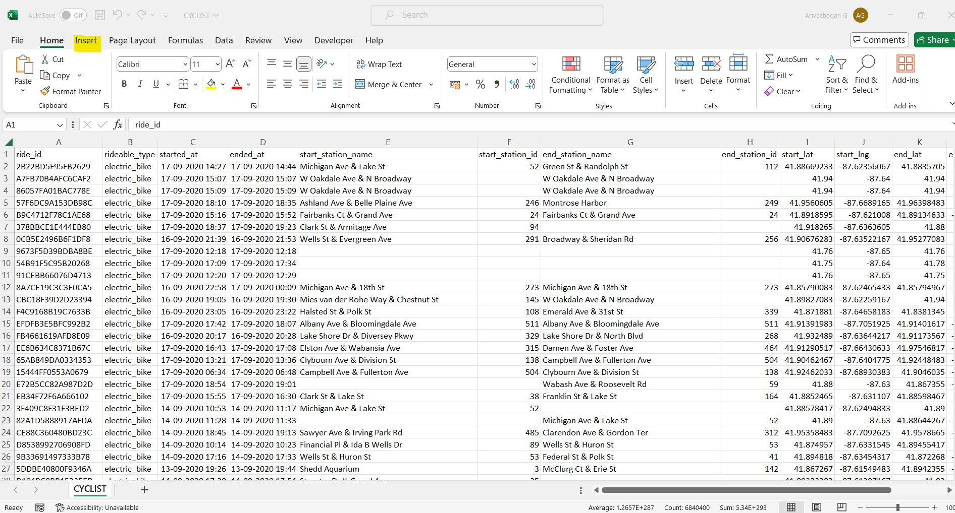
Steps-1
I use Excel Pivot tables to check the raw data structure.

Slide 5
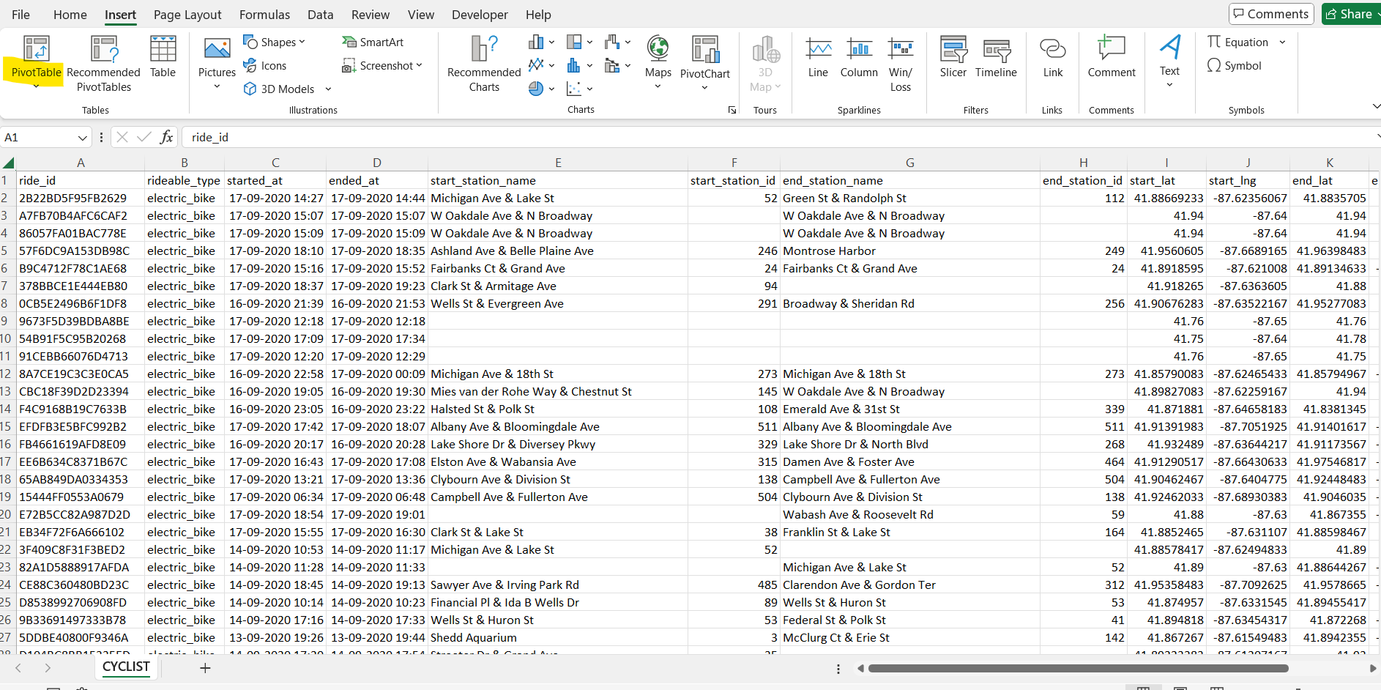
Steps-2
Click the pivot table option

Slide 6
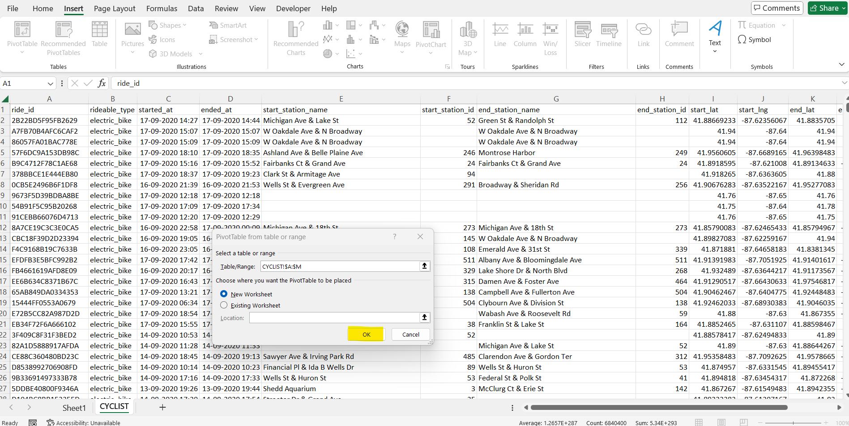
Steps-3
Now click on ok

Slide 7
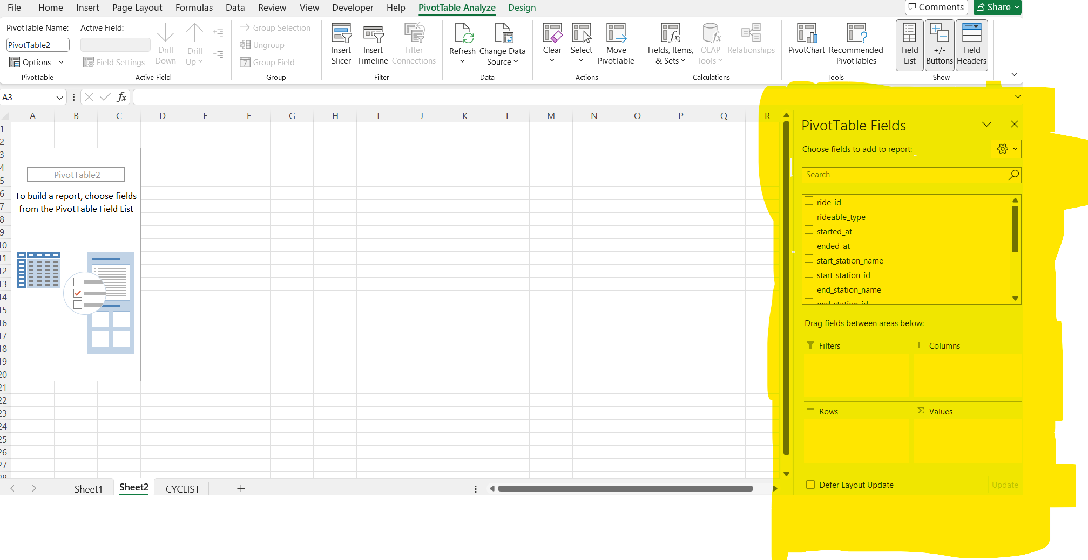
Steps-4
Now we can use the reside Pivot fields to see our data in custom views

Slide 8
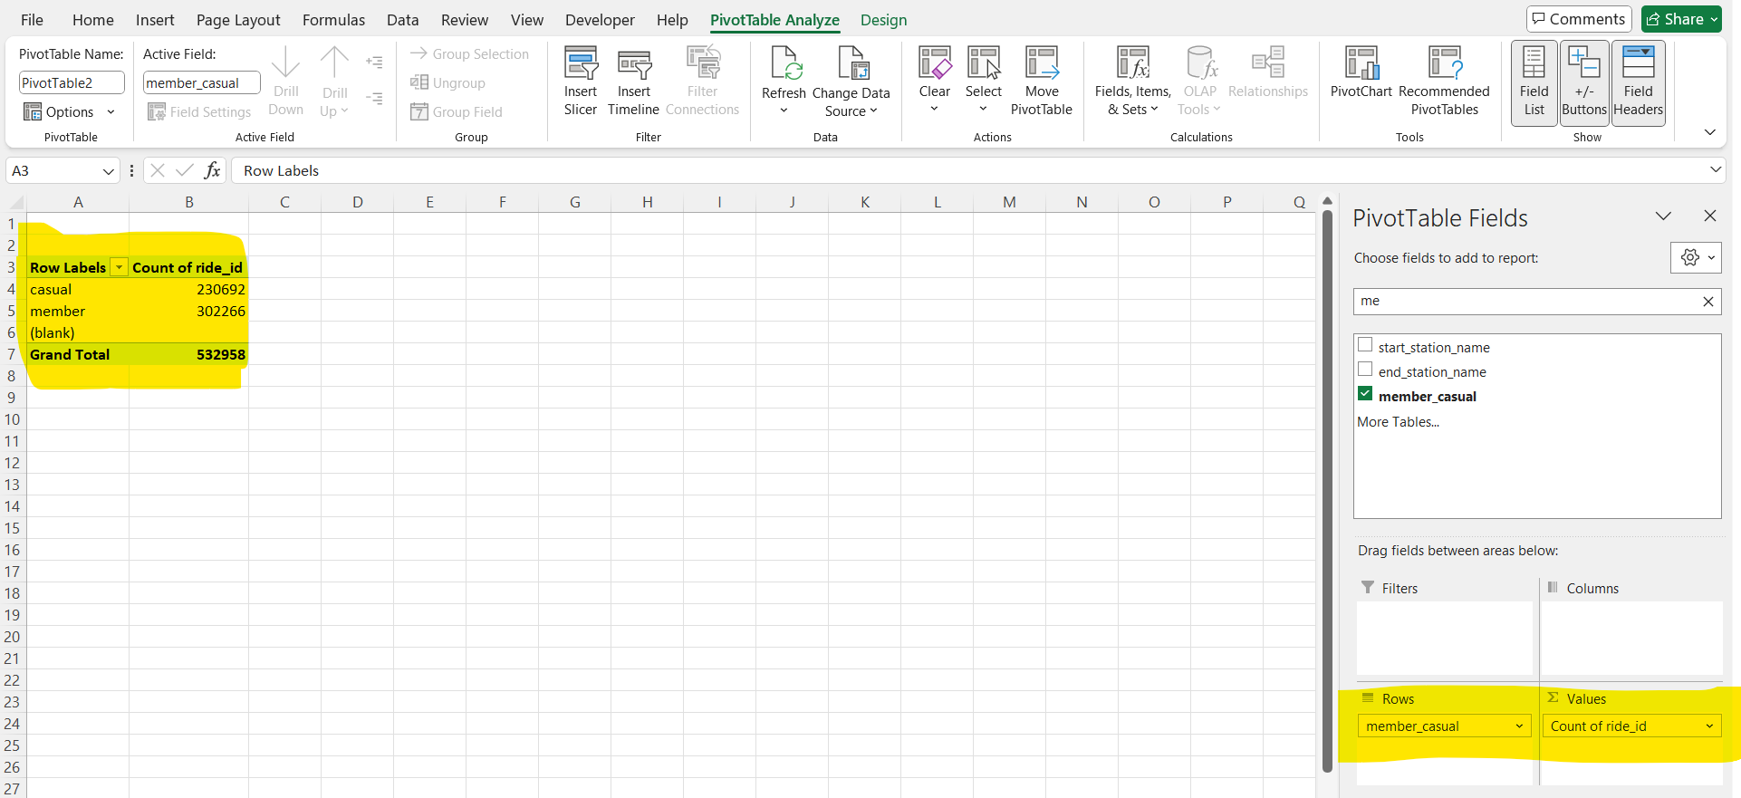
Steps-5
Add Few rows and values to understand the data

Slide 9
Use Jupyter notebook
to treat null values

Slide 10
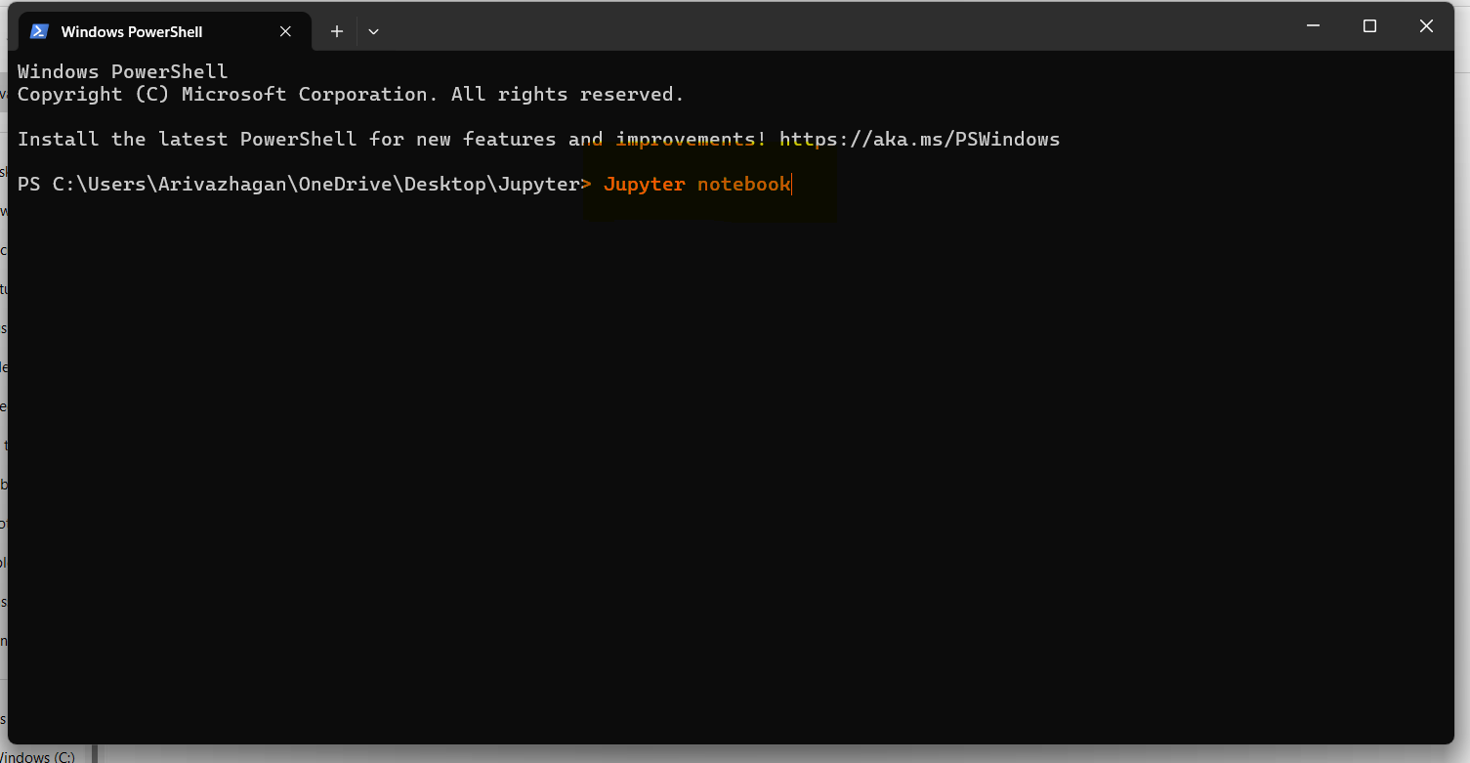
Steps-6
Right Click on windows powershell type Jupyter Notebook

Slide 11
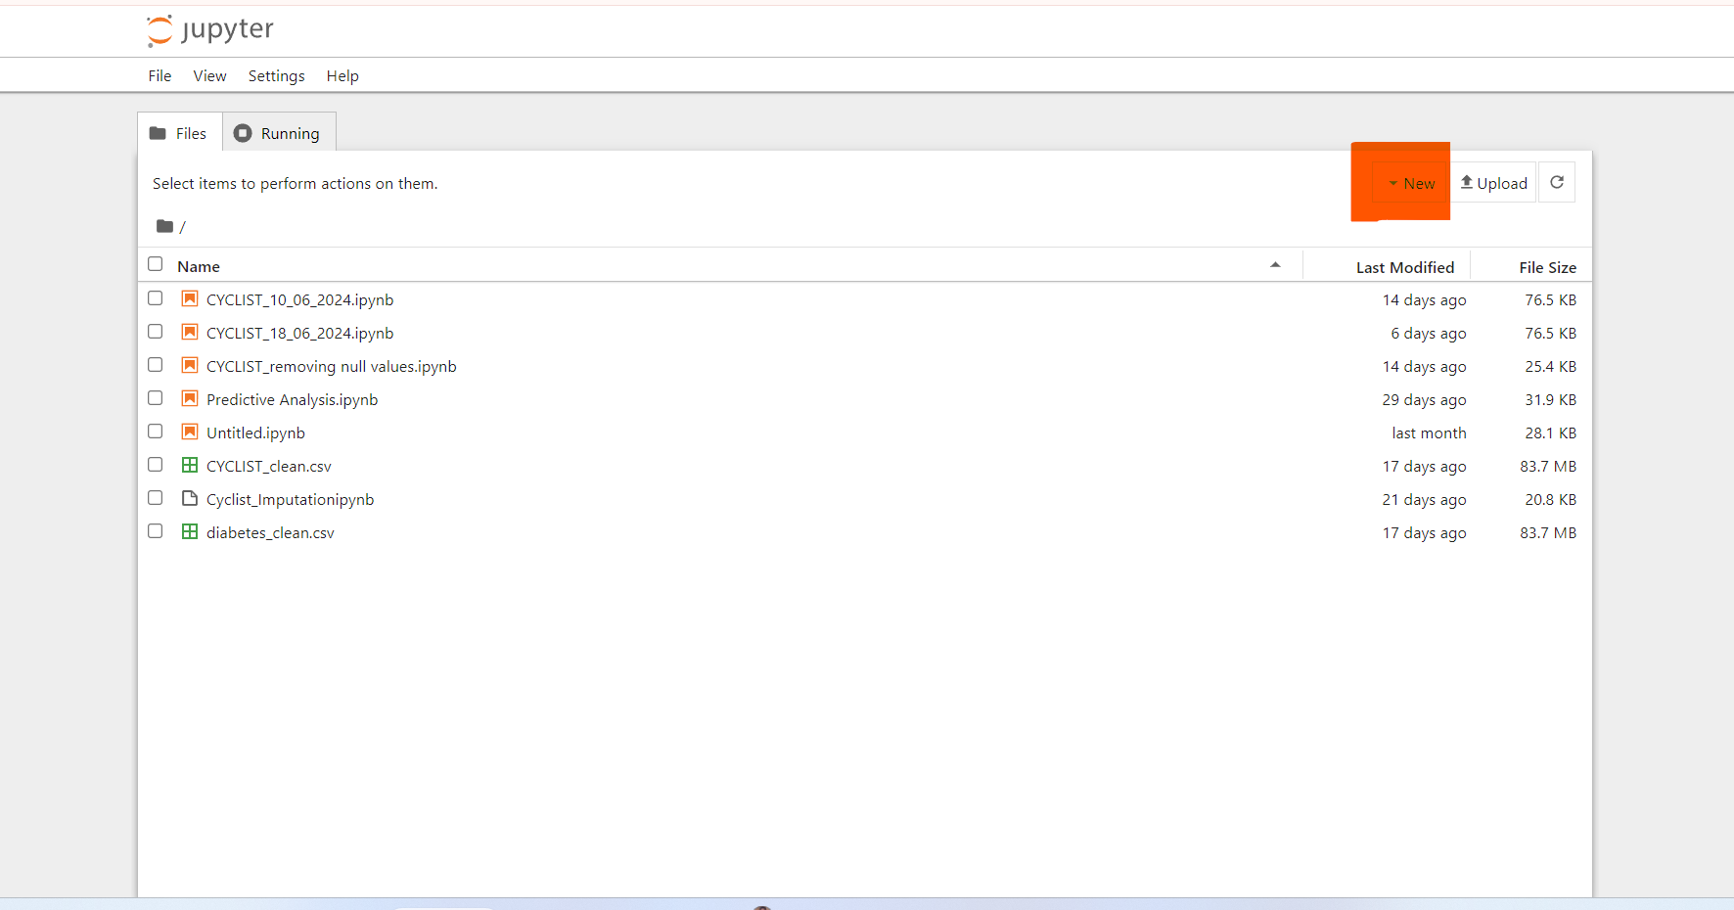
Steps-2
Now Click on new

Slide 12
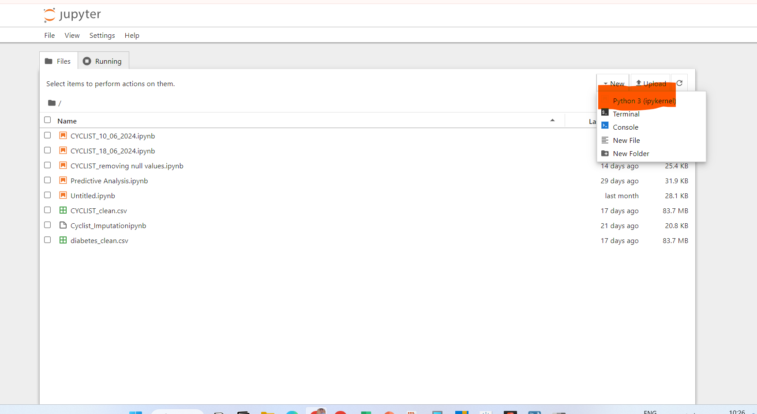
Steps-3
Now Click on Pythion 3

Slide 13
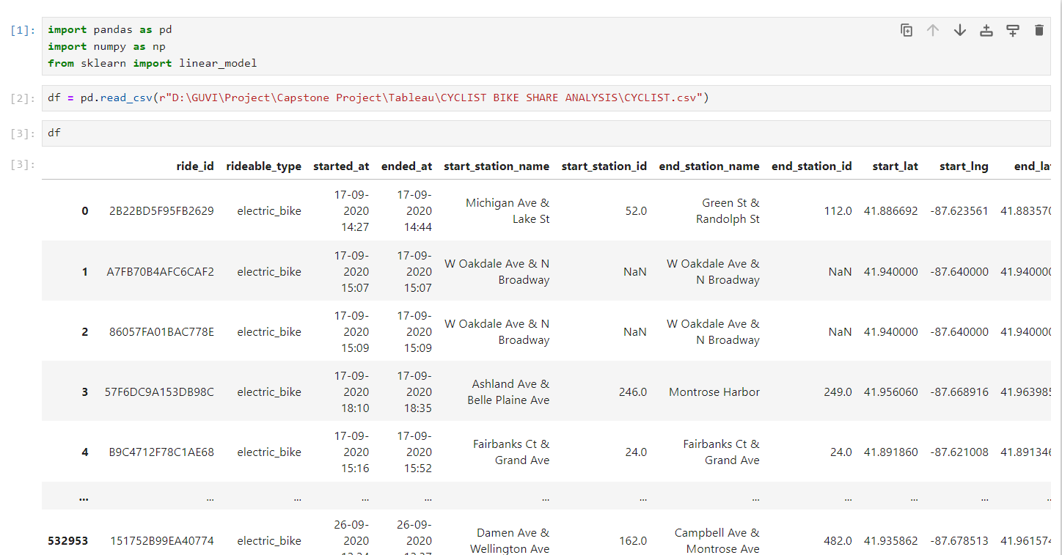
Steps-4
Enter the commands show in the following image
Your File location

Slide 14
Steps-5
Enter the commands show in the following image
Your File location

Slide 15
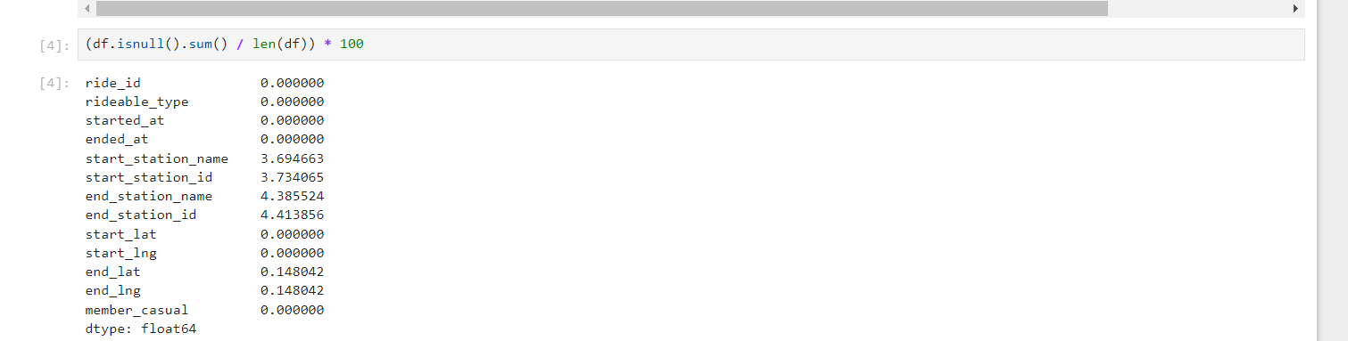
Steps-6
Now Check for null values
(df.isnull().sum() / len(df)) * 100
It is used to find the percentage of missing null values.

Slide 16
Note
Even though we have a small amount of missing values for one month's data:
Removing them might cause misleading analysis.
Therefore, we will impute the data for better and seamless analysis.

Slide 17
Note
Even though we have a small amount of missing values for one month's data:
Removing them might cause misleading analysis.
Therefore, we will impute the data for better and seamless analysis.
We use mode and mean to impute the values

Slide 18
Steps-7
Here is the process to create categorical values
Change the name to required column name
Change the name to required column name
We will use the mode to impute categorical values such as Start Station Name and End Station Name.

Slide 19
Steps-8
Here is the process formate
Change the name to required column name
Change the name to required column name
We will use the mode to impute categorical values such as Start Station Name and End Station Name.

Slide 20
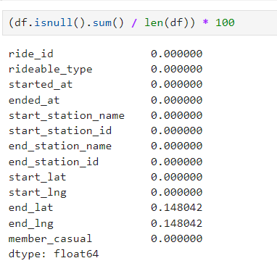
Steps-9
After using mode check the null status using is null function
Here you can see Start Station Name and End Station Name null values are imputed.

Slide 21
Steps-10
Change the name to required column name
Change the name to required column name
Now to treate null values in end_lat and end lng
We will sue .mean function

Slide 22
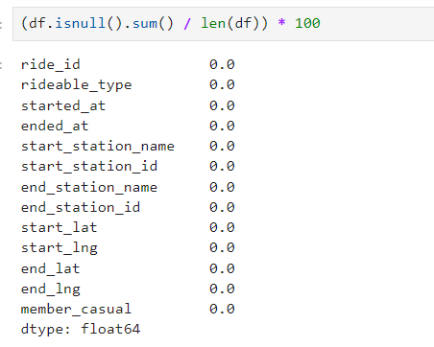
Steps-11
Now make sure all the null values are treated

Slide 23
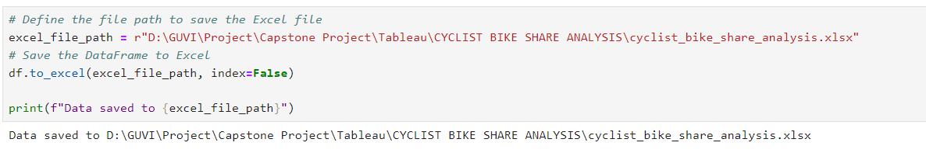
Steps-12
Change the location to your preferd location
Use the code above to download the cleaned data for analysis.

Slide 24
END
As part of data cleaning, adding calculated columns to the table is recommended.
We will upload this file to Tableau so we can add calculated fields and start our analysis.

